Slide 1


Using glTF Mesh in OpenSim
Ai Austin
https://blog.inf.ed.ac.uk/atate/

Slide 2
History
2011 – Collada Mesh Import
2023 – glTF PBR Materials Support in Second Life
2024 – glTF Mesh Import in Second Life under development
Mid 2025 – Second Life Viewer supports glTF Mesh Upload
Mid 2025 – glTF Mesh Import Supported in Firestorm Viewer (+others)
Future – Wider adoption of glTF Standards

Slide 3
glTF Mesh Import Workflow
Obtain or create 3D model.
Tidy the model up in a 3D modeller such as Blender.
Export to glTF (usually as .glb incorporating all textures and materials).
Check the model in a glTF Model Viewer.
Transform (usually to simplify) the glTF model.
Check the model again in a glTF Model Viewer. Try to remain under the mesh uploader limitations where possible.
Import the transformed glTF mesh back into a 3D modeller such as Blender to make any changes you wish and if necessary to split the model into parts that can be separately imported to allow for scale 1.0 or as a single linkset in inventory after upload.
Export the final glTF mesh.
Import to Second Life or OpenSim (include textures).
Import again into the PBR materials uploader if you want the PBR materials in the model. But currently they must be applied manually after upload. This will change when an integrated mechanism is provided as planned.

Slide 4
Sources of glTF Mesh Models
Khronos Group: glTF Sample Models
NASA 3D Resources: A repository of 3D models, 3D printable models, and textures
Sketchup 3D Warehouse
Your own Creations in 3D Modellers: Blender, etc.
OpenSim originated content (e.g. prim builds) exported via Firestorm “Save as” Collada (not glTF yet) and imported to a 3D Modeller.

Slide 5
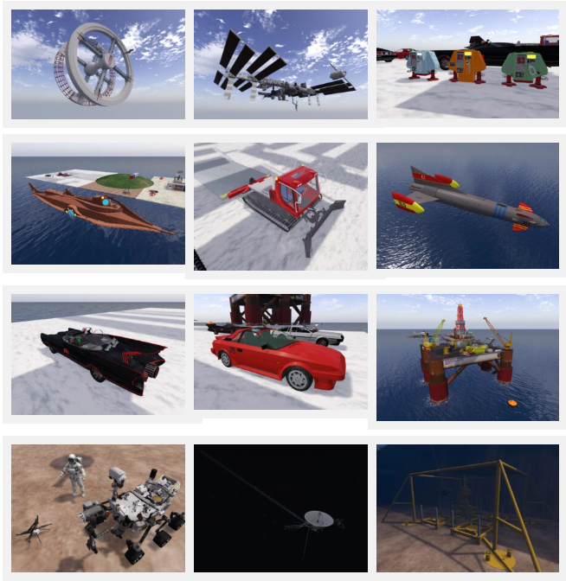
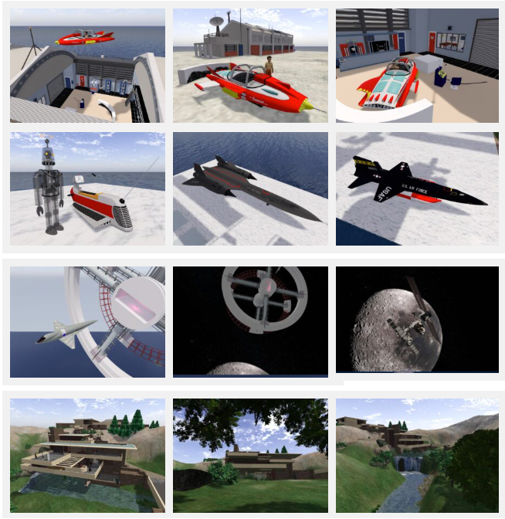

Slide 6
Current Limitations on glTF Mesh
Mesh parts with more than 65,534 vertices are split by the mesh uploader into multiple “faces”. If object goes over 8 faces, extra faces become ‘submodels’ and those have limits.
Any mesh part cannot have more than 8 materials. Sub-meshes with more than 8 materials will be split into more meshes in a future build.
The mesh uploader uses a viewer debug setting of ImporterModelLimit (default 768) as a limit of the number of mesh parts. There cannot be more than 4,000 mesh parts (called instances in the mesh loader stats) in a model.
Models must be less than 52,428,800 bytes in total.
There must be less than 256 mesh parts (instances) in a model or the model will upload without linking into one inventory item which can make it difficult to edit, move or delete when rezzed in world.
Mesh part limits (in metres) – Min. <0.01, 0.01, 0.01> (parts will be set to this limit if smaller) Second Life Max. <64.0, 64.0, 64.0> OpenSim Max. <256.0, 256.0, 256.0>
Only one glTF scene is loaded at present – the default scene or first scene if no default.
Rigged meshes cannot have more than four joint weights per vertex. Rigged meshes must be rigged in accordance with one of the Second Life skeletons.

Slide 7
Tips to successfully use glTF Models in OpenSim
Obtain or create your model and make sure to keep the creation safely even if you make versions with simplifications or splitting into parts. Export original .glb model from there.
Always check that the model is within the limitations specified. If there are too many mesh parts the item on import will be a potentially large number of separate coalesced objects in inventory and after rezzing can be difficult to manage or delete.
Use glTF Viewers to make sure the glTF mesh appears as you wish and to look at basic statistics of number of meshes, number of triangles, etc.
Use glTF Transformation tools to simplify the meshes, weld common material parts together where feasible, etc.
Check the overall size of any glTF mesh and if larger than the limitation, consider splitting it into parts.

Slide 8
glTF Tools
GlTF Model Viewers
Khronos Group glTF Sample Viewer can be used to view the glTF models and in an “Advanced Mode” tab to examine statistics such mesh parts count, triangle count and counts for materials. Also available is the ModelViewer.dev glTF/GLB Viewer which uses “PBR Neutral” lighting with a simple white background which can be useful for photo capture of the models.
Mesh Optimisation Prior to Import – glTF Transformation Tools
glb.babylonpress.org and gltf.report are examples of “glTF Transformation” tools which can simplify the glTF prior to upload to make it more suitable and come under some of the limitations to avoid things like model splitting failing to import as a single linkset which would mean many separate objects when an item is rezzed from inventory..
These are essential for complex models. Keep the original model in the 3D modeller of choice, e.g. Blender, but export to glTF and then transform that prior to upload into Second Life or OpenSim.
Keep texture format as original as the tools usually convert to webp image format otherwise.
You can adjust other settings, but most defaults will work fine. But even though some of the tools are based on the same underlying code library they do have different defaults which can be worth exploring to achieve your purpose when the mesh is uploaded.

Slide 9
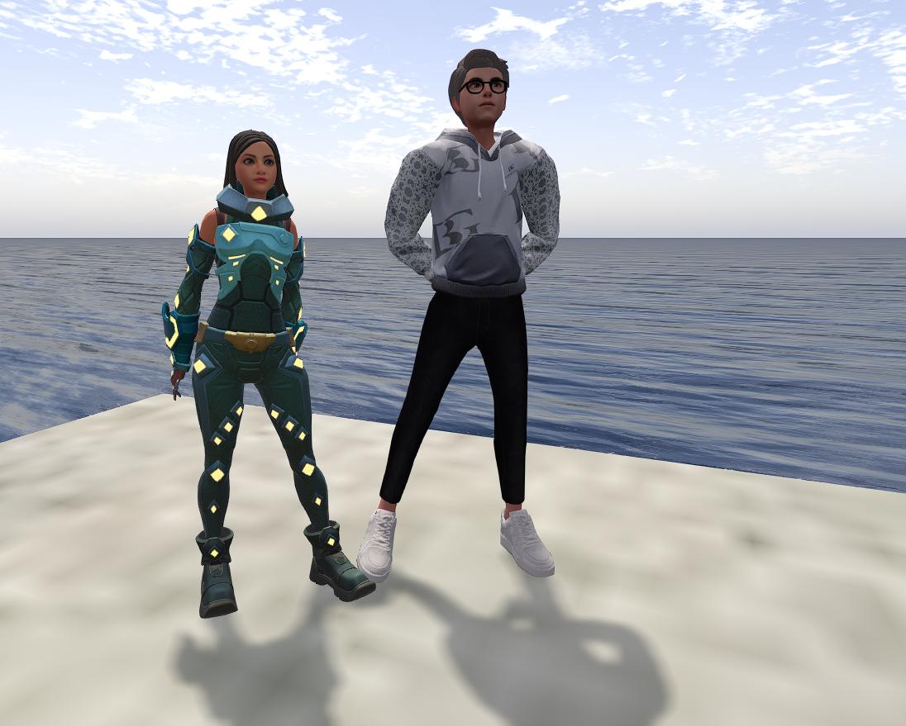
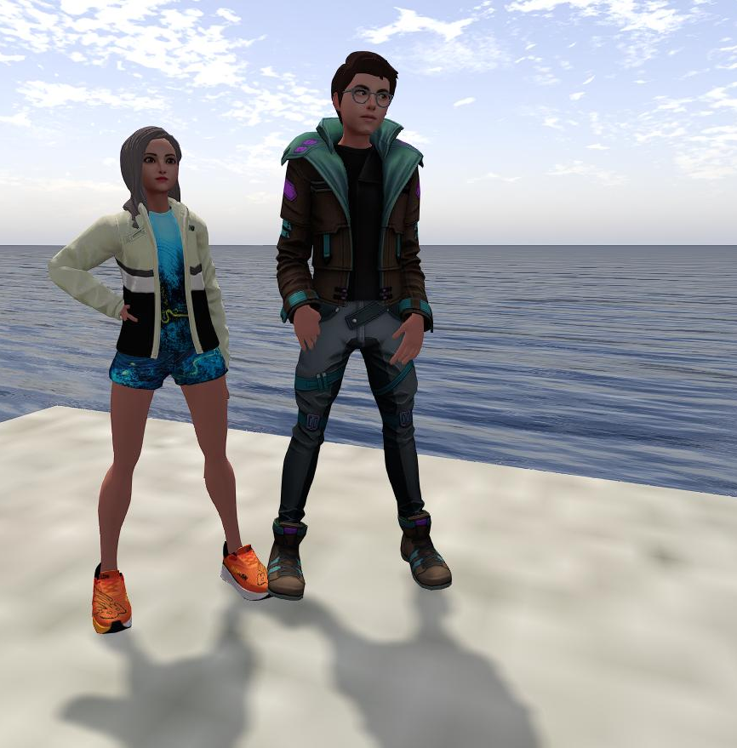
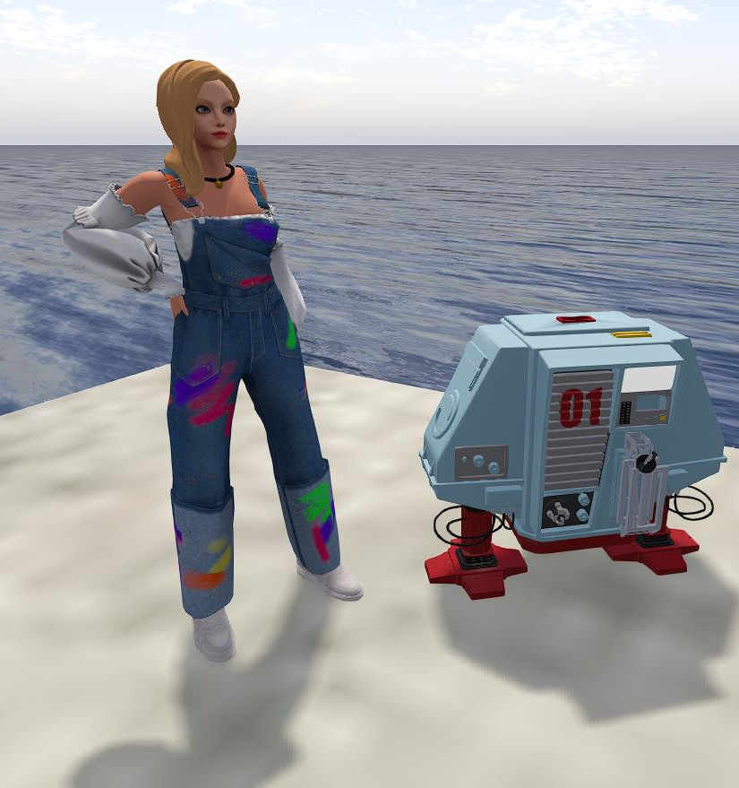
glTF Rigged Mesh and Avatars

Slide 10
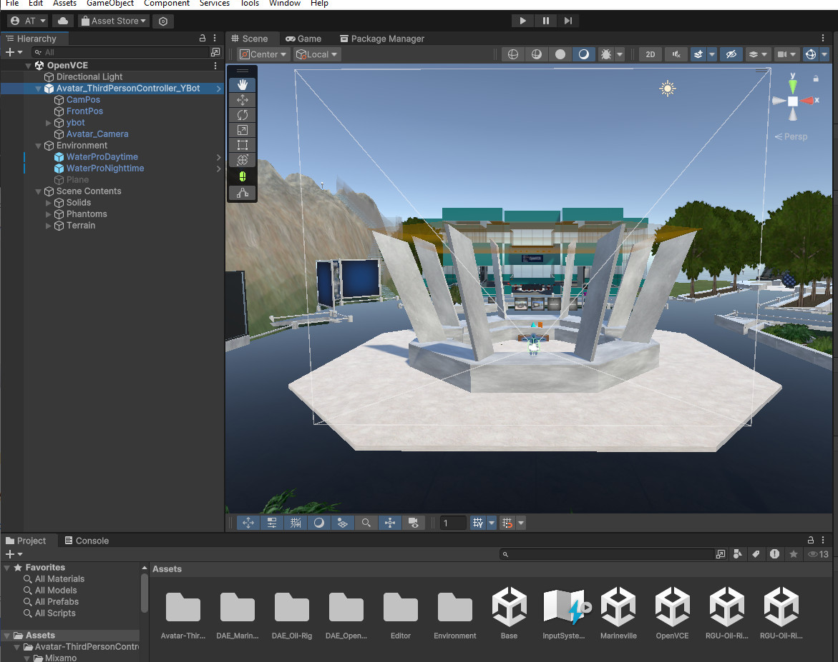
glTF in OAR Converter
OAR Converter is a tool to take OpenSim Archive (OAR) Files and convert them to Collada or OBJ 3d mesh formats for use in external tools and platforms such as 3D modellers like Blender, or game and app development platforms like Unity and Unreal Engine, etc. It is now also able to convert to glTF which opens interesting opportunities including the possibility of reimporting modified content back into OpenSim.

Slide 11
Using glTF Mesh in OpenSim
Ai Austin
More details and links in blog post at
https://blog.inf.ed.ac.uk/atate/

