Slide 1
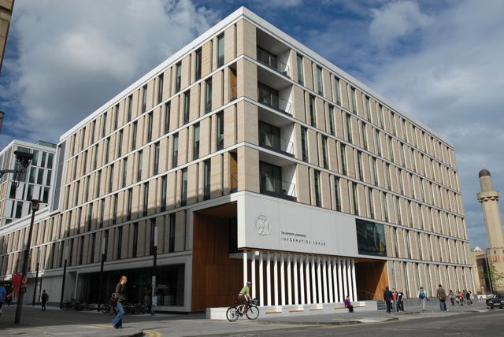
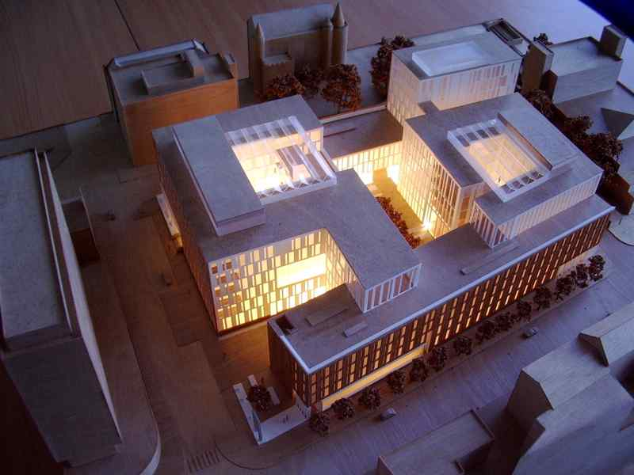
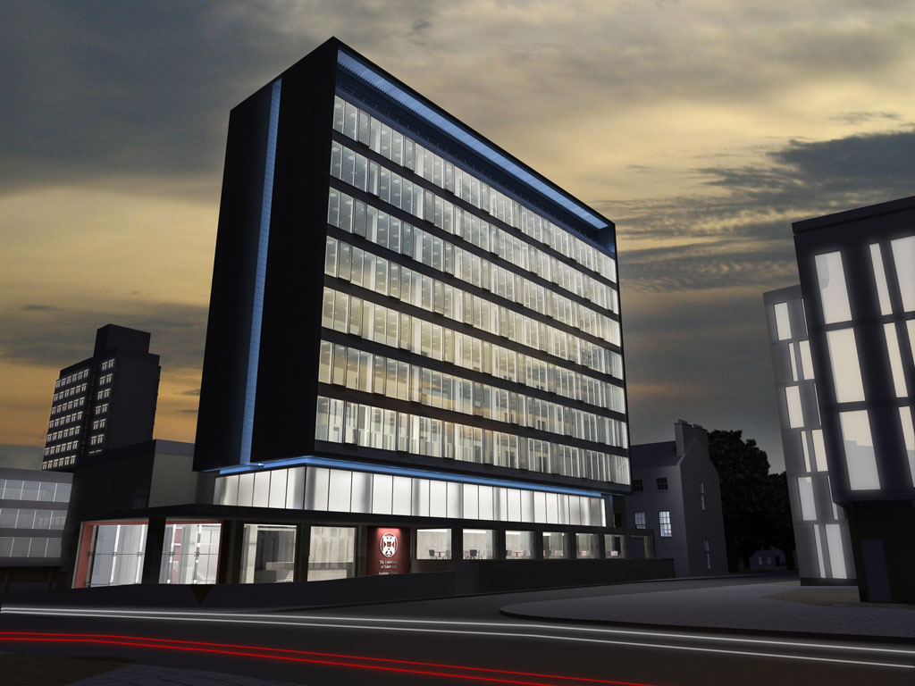
Welcome to Informatics

Slide 2
People
On the premises:
  ~ 100 Academic staff
  ~ 150 Postdoc researchers
  ~ 80 Support staff
  ~ 250 PhD students
  ~ 200 Masters students
  ~ 400 Undergraduates (200 1st year)
20% Software Engineering
50% Computer Science
30% Other joint programmes
(AI, Cog Sci,Maths, etc).
Graduating students:
PhD: ~70 per year
MSc: ~200 per year
Undergraduate: ~100 per year

Slide 3
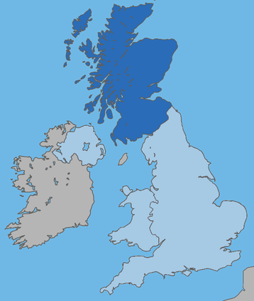
RAE Top 10 CS/Informatics Universities
World leading
Internationally excellent
69% more top rated research than nearest competitor 10% of all UK “world leading” research
www.rae.ac.uk
Notes:
3

Slide 4
Recent Awards
2 Fellows of Royal Society
1 Fellow of British Academy
4 Fellows of Royal Academy of Engineering
12 Fellows of Royal Society of Edinburgh
3 Academia Europea
10 Fellows of British Computer Society
3 BCS Roger Needham Awards
2 ACM Fellows
1 Fellow of Cognitive Science Society
5 AAAI Fellows
1 Herbrand Award
1 IJCAI award for Research Excellence
4 Water Saver Award,
Stanford Global Enterprise Week:
6 Young Scottish Software Engineer of the Year
1 Google Anita Borg Scholarship
1 Young Scientist Award, AMLaP
3 RSE Enterprise Scholarship
1 Shell Technology and Enterprise Program,
most enterprising student in UK Award
3 Sir William Siemens medal

Slide 5
Teaching
Depth and breadth:
  Longest tradition of teaching in CS/AI in UK
  One of the largest Masters ICT programmes in UK
Engagement:
  Experience of joint provision with ICT Labs partners
Quality:
  Half the Young Software Engineers of the Year in the last decade were from Informatics
  Many MSc/UG theses lead to published results or innovation (e.g. Ian Clarke’s thesis “A Distributed Decentralised Information Storage and Retrieval System” led to Freenet)
Innovation:
  Routine: (e.g. lecture capture on video (23,000 video downloads)
  New: (e.g. MOOCs – Coursera collaboration)

Slide 6
ProspeKT + Informatics Ventures
AspeKT + CGES + Design Informatics
Startups and spinouts: | 33 generated £5M investment £3M sales
Hub effect: | 250 companies 17 universities
Entrepreneurial training: | 23,000 hours delivery 1000 participants £11M for 75 companies
Edinburgh holds UK record for number of university spinoff companies in last 10 years.
Informatics, if it was a university, would come 4th in UK.
spinoutsuk.co.uk

Slide 7
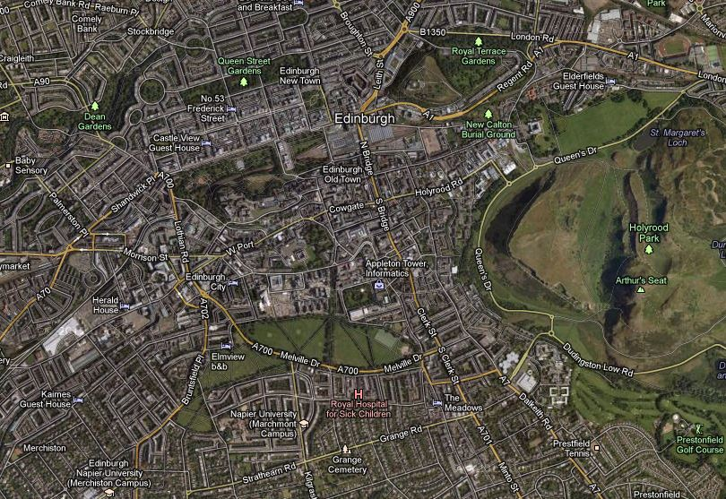






















































Edinburgh Start-up Ecosystem
Silicon Walk
Waverley Gate
Appleton Tower
Evo House
Quartermile
Techcube

Slide 8
Foundations for a new science
The science of information – how natural and artificial systems process, store and communicate information
  A fundamental science underpinning all areas of life - Academic, Industrial and Social.
  Encompasses sub-disciplines such as Computer Science, Artificial Intelligence and Cognitive Science
This view of informatics is necessary because:
Big technological problems are multi-disciplinary
Big societal problems demand integrative science
Notes:
Why our aims are significant for science.

Slide 9
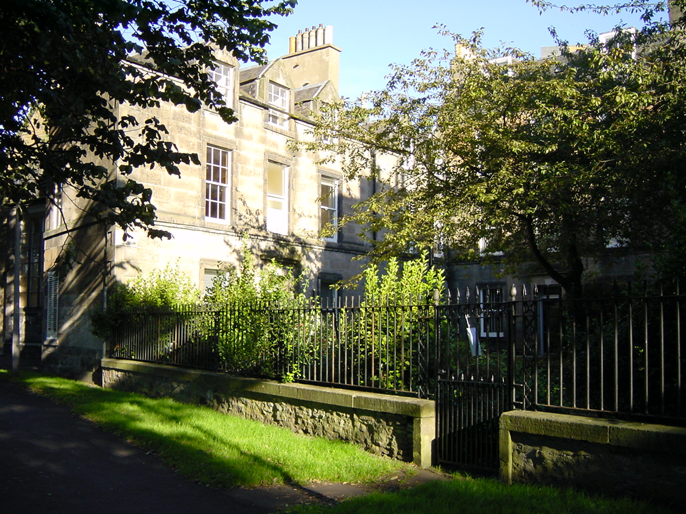
Classical Period (1965-1984)
Roots of our science:
State
Logic
Led to major breakthroughs, including:
Types and functional programming
Logic programming
Formal verification
Natural language processing
Notes:
First of a sequence of four slides giving a potted history of informatics at Edinburgh (slightly skewed to the topics with which I feel most comfortable).

Slide 10
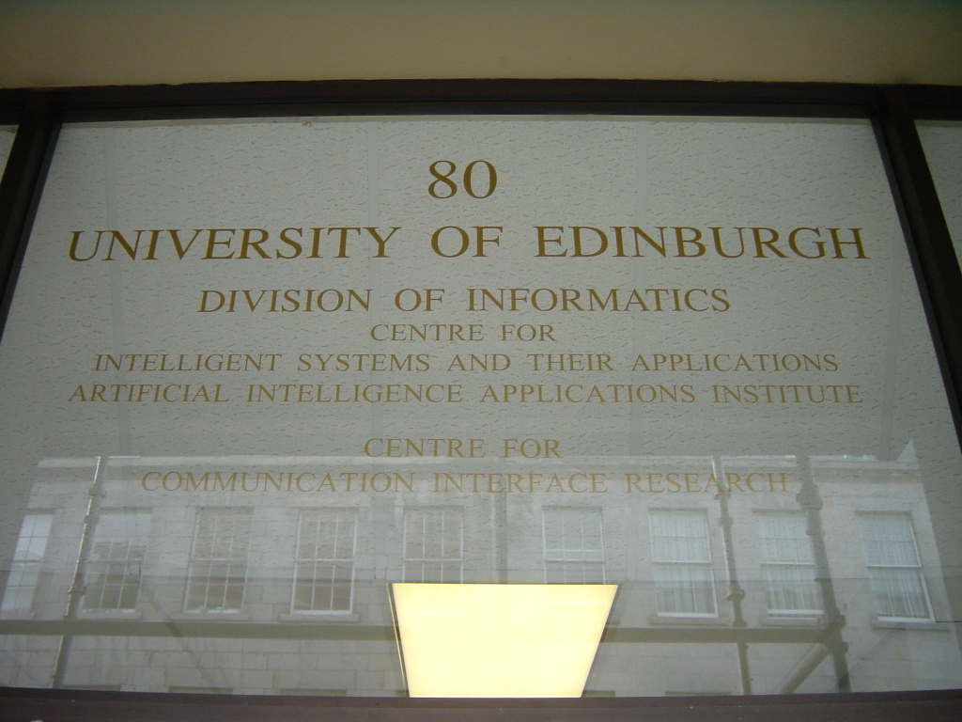
Eclectic Period (1985-1999)
Emergence of sub-disciplines:
Many sub-fields
Many institutes
Led to major breakthroughs, including:
Proof planning
Algorithmic skeletons for parallel computation
Modular speech synthesis systems
3D imaging

Slide 11
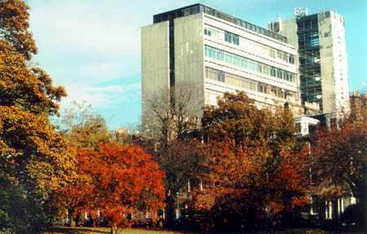
Modern Period (2000-2007)
Technologies begin to scale:
Internet scale
Ubiquitous
Led to major breakthroughs, including:
XML databases
Peer to peer knowledge sharing systems
Very large scale learning systems
Proof carrying code

Slide 12
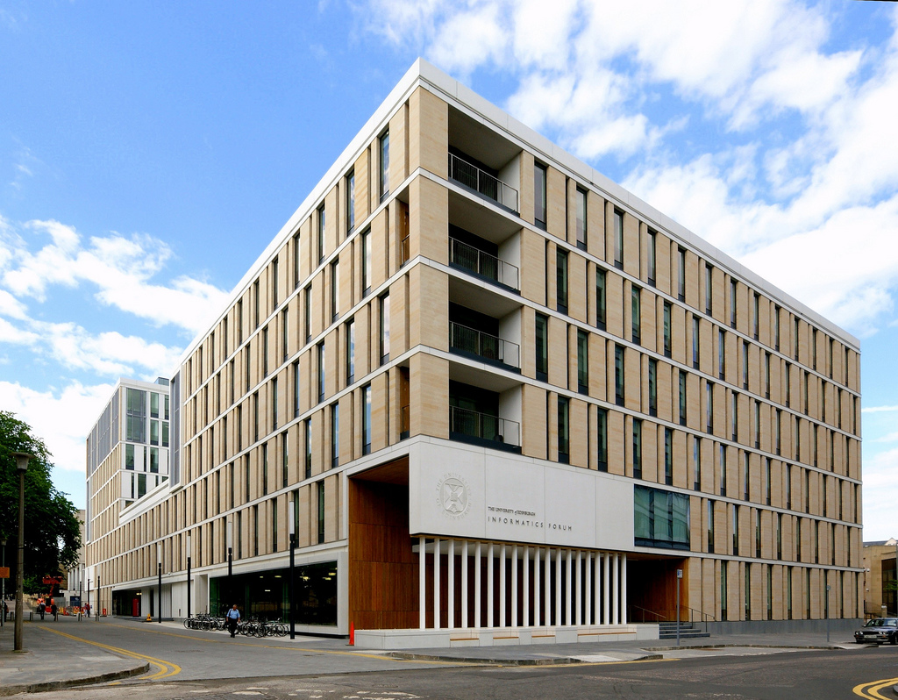
Post-Modern Period (2008+)
Maturing as a science:
Common core
Computational scholarship
Symbiosis with other sciences
Impact on design and innovation
Leading to major breakthroughs, including:
High performance, low power micro-architectures
Humanoid robotics
Network science
Computational biomedicine

Slide 13
Our research landscape
Databases
Quantum
computation
Multimodal
interaction
Semantics &
discourse
Algorithms &
complexity
Verification &
security
Automated
reasoning &
knowledge
engineering
Speech synthesis
and recognition
Algebra, games
& concurrency
Cognitive
modelling
Software
engineering
Systems
modelling
Graphics and
animation
information
extraction
Data-
intensive
research
Multi-agent systems
and planning
Bioinformatics
Large scale
natural
language
processing
Robotics
Computer
vision
Machine
learning
Wireless
sensor
networks
Computer
systems
architecture
Neuro-
informatics

Slide 14
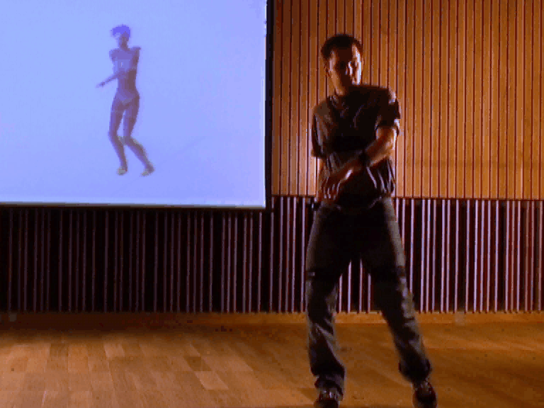
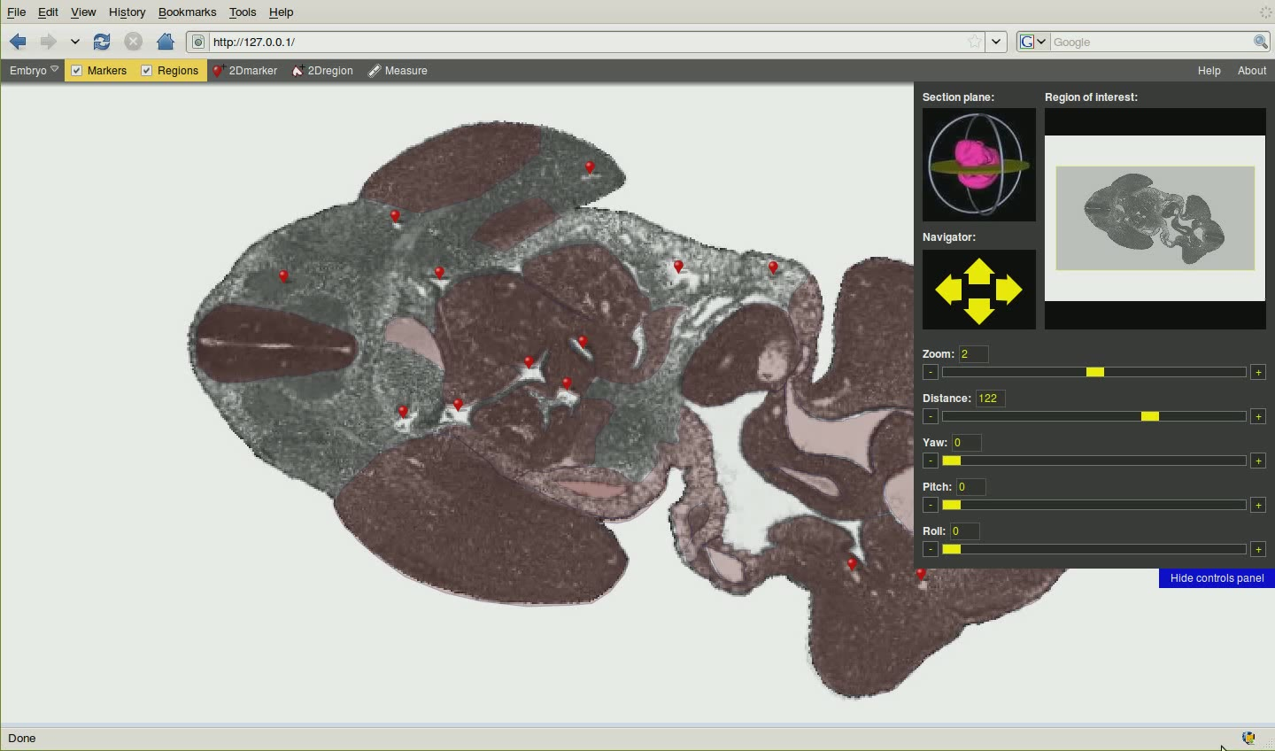
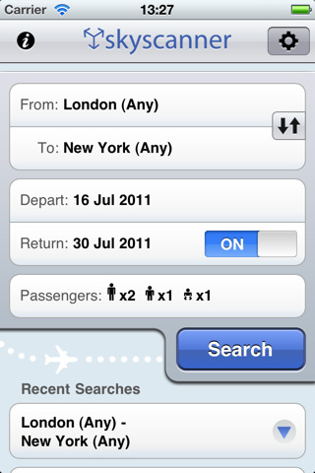
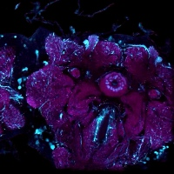
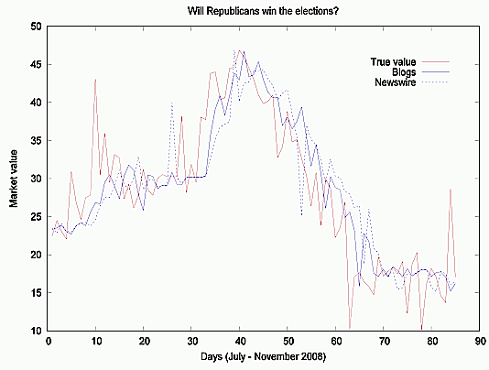
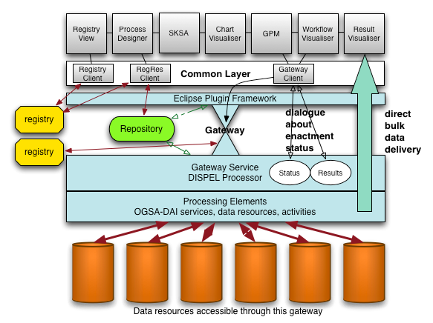
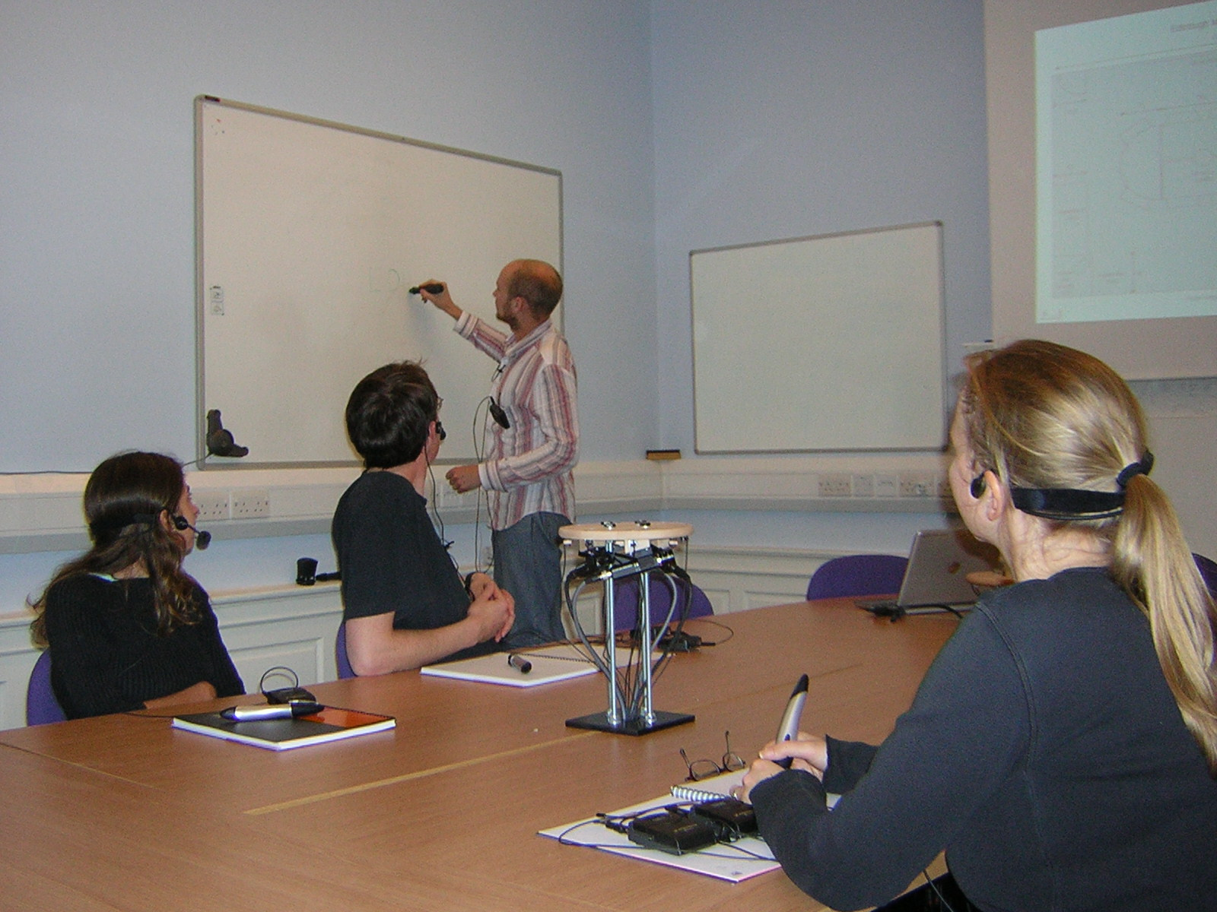
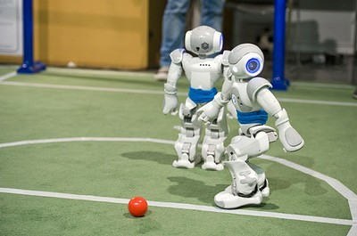
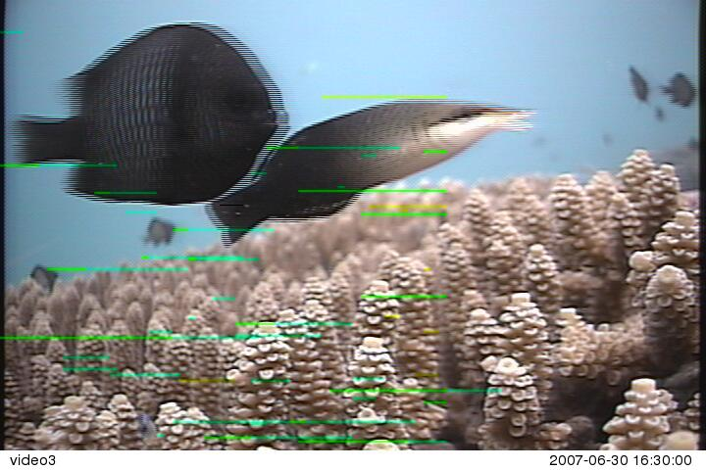
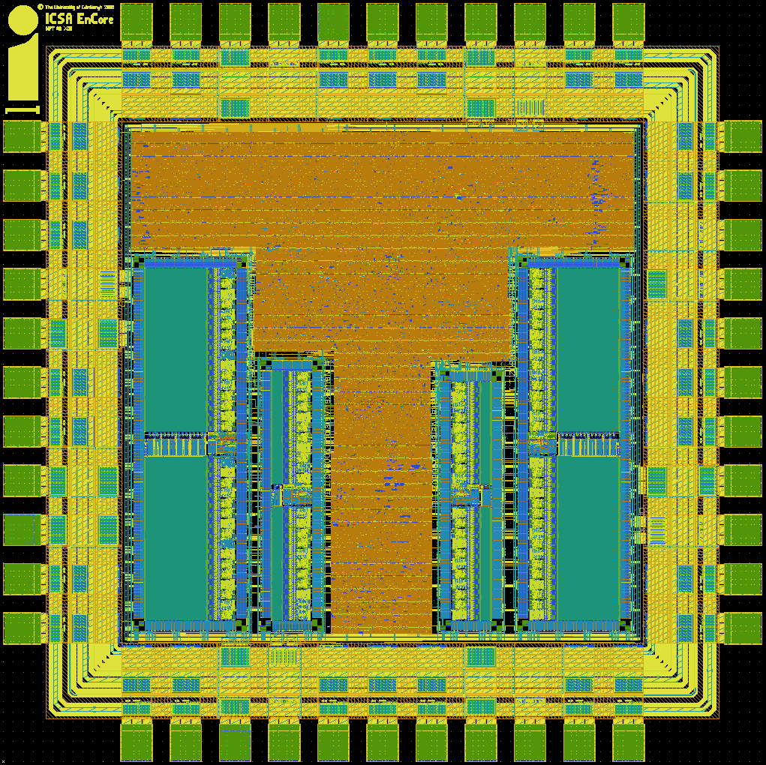
An example of our breadth
Data from individuals
from “society”
and from the environment
being curated
modelled
and coordinated
to return through new systems
that are more benevolent

Slide 15
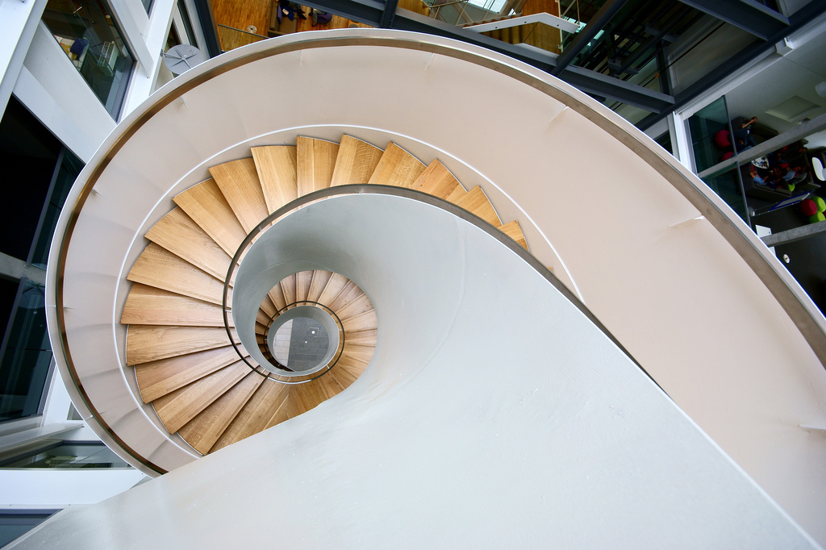
www.inf.ed.ac.uk
Notes:
Thankyou and welcome.

