Slide 1
Autonomous & Intelligent Systems
ENGINEERING AND PHYSICAL SCIENCES RESEARCH COUNCIL
Dr Simon Crook (Senior Manager, Aerospace, Defence & Marine)

Slide 2
Background
Autonomous and intelligent systems which are capable of independent action in dynamic, unpredictable environments are a challenge in a number of scenarios.
In order to contribute to the future research interests of the EPSRC partner companies, we are inviting novel research leading to future exploitable technologies for autonomous and intelligent system following successful research programmes.
It is expected that many academic disciplines will have research ideas to contribute to this call.

Slide 3
Key Points
To fund novel TRL 1-3 research in autonomous and intelligent systems
Up to £6M available
Grants up to 5 years in length
Co-sponsored by EPSRC, BAE Systems, Network Rail, Scisys, Schlumberger, DSTL, UK Space Agency, NNL & Sellafield Ltd.
Closing Date 4th August
Projects start by 31st March 2011

Slide 4
Research Areas
• software architectures
• sensor exploitation
• situational awareness
• decision making and planning
• information management
• Verification of autonomous systems
• Model building and learning
Proposals must target at least one area. We are not looking for a finished system but technologies which may be exploited for future autonomous and intelligent systems.

Slide 5
Who Can Apply & How
Higher Education Institutions, research council institutes and independent research organisations.
Full list at : http://www.rcuk.ac.uk/research/Pages/Eligibilityforrcs.aspx
Via the joint electronic Submission System (Je-S). Instructions and guidance are in the call document.
Note the new policy on equipment funding applies.

Slide 6
Assessment Criteria
Full postal peer review with opportunity for the applicant to address reviewer comments ahead of the decision panel
Decision panel comprised of academics and sponsoring industrialists
Proposal awarded via:
Scientific Quality and merit
A high quality vision contributing to at least one of the research needs of the call
Relevance to the partner interests as set out in the table shown in the call document.
Panel meets in December 2011

Slide 7
Collaboration & Contacts
EPSRC does not claim any of the IPR for the proportion of work funded by it. As there are also industrial sponsors providing funding IPR/collaborative agreements will be expected to be agreed by successful applicants with the consortia of co-sponsoring companies.
No funding will be released until this has been completed.
All general call queries regarding the call should be directed through EPSRC via Simon Crook in the first instance.

Slide 8
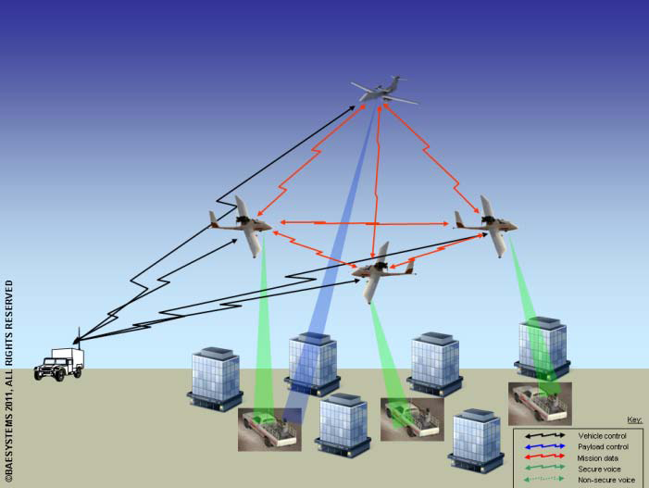
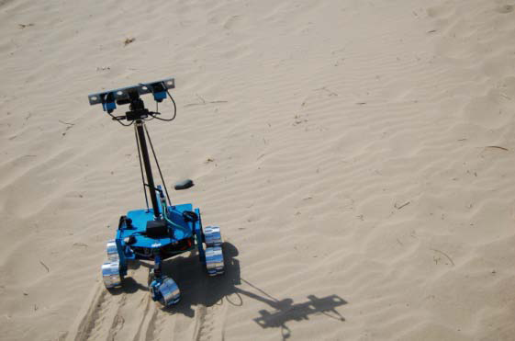
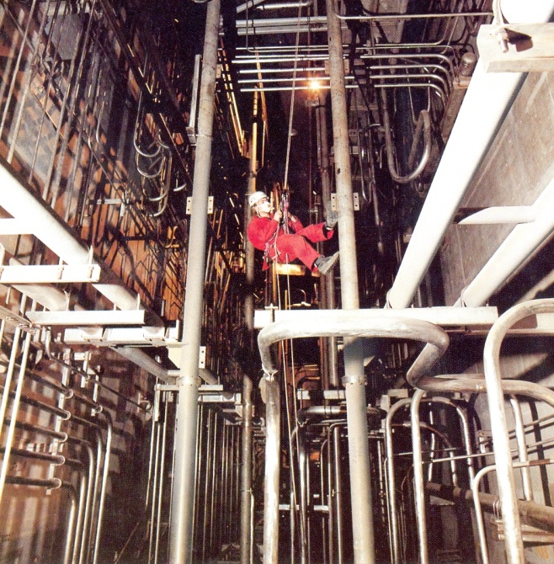
Example Scenarios
Rail Infrastructure
Mars Rover
Nuclear Decommissioning by Tele-autonomy
Co-operative Vehicles
Notes:
Key points to make:
Speak to your research office and relevant portfolio manager if unsure
Instrument development (>£10k) is out of the scope of new rules but justification of resources will be scrutinised
Equipment sharing approach is being developed right now (priority for EPSRC) – speak to infrastructure programme (Emma Jones, Matt Davies, Susan Morell) for more advice.

Slide 9
Some FAQ’s so far…..
Scale of grant, consortium or single applicant?
Do I need to be a partner with one of the companies already or as part of the proposal?
Can I bring in other company partners?
Are you looking for a complete vehicle/system?
The closing date is relatively short, can I have an extension?

Slide 10
Questions?

