Slide 1
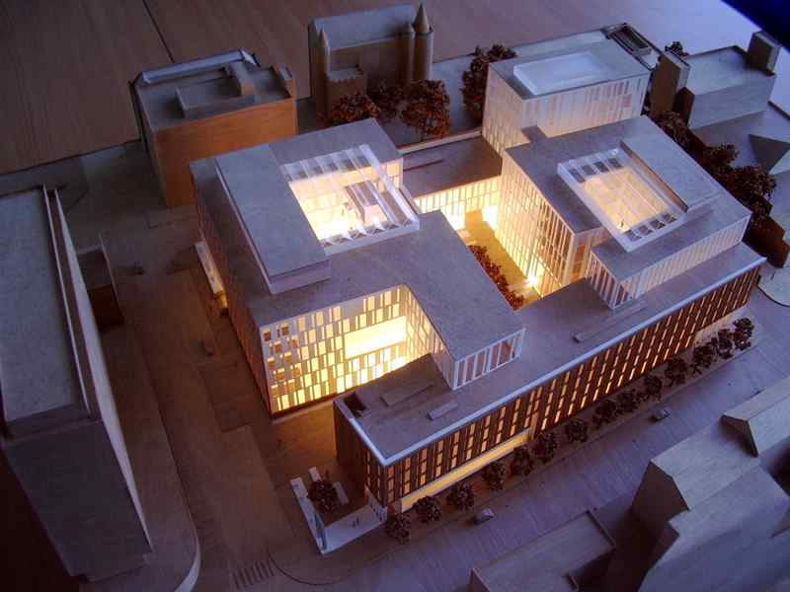
Welcome to Informatics

Slide 2
People
On the premises:
~ 100 Academic staff
~ 150 Postdoc researchers
~ 80 Support staff
~ 250 PhD students
~ 200 Masters students
~ 400 Undergraduates (200 1st year)
20% Software Engineering
50% Computer Science
30% Other joint programmes
(AI, Cog Sci,Maths, etc).
Graduating students:
PhD: ~70 per year
MSc: ~200 per year
Undergraduate: ~100 per year

Slide 3
RAE Top 10 CS/Informatics Universities
World leading
Internationally excellent
69% more top rated research than nearest competitor 10% of all UK “world leading” research
www.rae.ac.uk
Notes:
3

Slide 4
ProspeKT + Informatics Ventures
AspeKT + CGES + Design Informatics
Startups and spinouts: | 33 generated £5M investment £3M sales
Hub effect: | 250 companies 17 universities
Entrepreneurial training: | 23,000 hours delivery 1000 participants £11M for 75 companies
Edinburgh holds UK record for number of university spinoff companies in last 10 years.
Informatics, if it was a university, would come 4th in UK.
spinoutsuk.co.uk

Slide 5
Edinburgh Start-up Ecosystem
Silicon Walk
Waverley Gate
Appleton Tower
Evo House
Quartermile
Techcube

Slide 6
Foundations for a new science
The science of information – how natural and artificial systems process, store and communicate information
A fundamental science underpinning all areas of life - Academic, Industrial and Social.
Encompasses sub-disciplines such as Computer Science, Artificial Intelligence and Cognitive Science
This view of informatics is necessary because:
Big technological problems are multi-disciplinary
Big societal problems demand integrative science
Notes:
Why our aims are significant for science.

Slide 7
Our research landscape
Databases
Quantum
computation
Multimodal
interaction
Semantics &
discourse
Algorithms &
complexity
Verification &
security
Automated
reasoning &
knowledge
engineering
Speech synthesis
and recognition
Algebra, games
& concurrency
Cognitive
modelling
Software
engineering
Systems
modelling
Graphics and
animation
information
extraction
Data-
intensive
research
Multi-agent systems
and planning
Bioinformatics
Large scale
natural
language
processing
Robotics
Computer
vision
Machine
learning
Wireless
sensor
networks
Computer
systems
architecture
Neuro-
informatics

