Slide 1
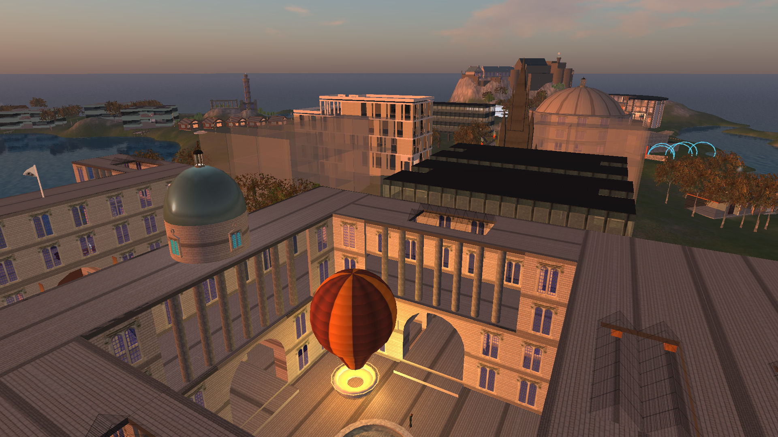
Vue – Virtual University of Edinburgh
The Vue group is a virtual educational and research institute bringing together all those interested in the use of virtual worlds for teaching, research and outreach related to the University of Edinburgh.
http://vue.ed.ac.uk
Contact: Prof. Austin Tate <a.tate@ed.ac.uk>

Slide 2
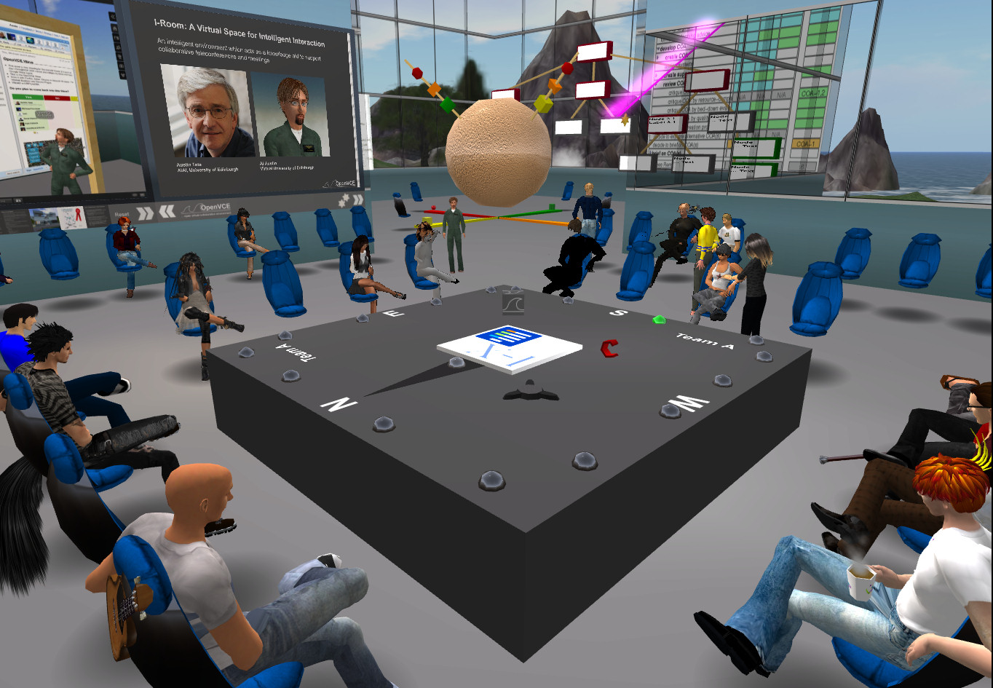
I-Room: a Virtual Space for Intelligent Interaction
The I-Room virtual environment is a shared persistent space, founded on process methodologies and offering intelligent systems support for interaction and collaboration between users, systems and agents.
"I" stands variously for intelligent, information, interactive, integrated and instrumented -
http://openvce.net/iroom

Slide 3
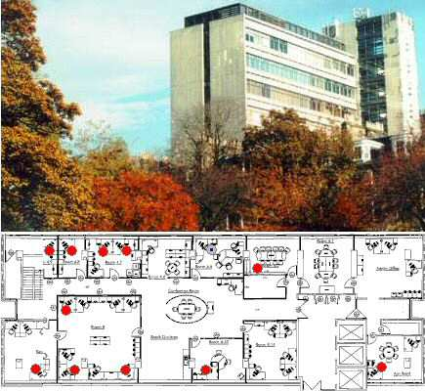
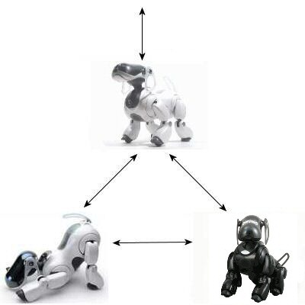
Project AIBO
A project which explored artificial intelligence technology to support team work between human and robotic systems working in a cooperative and safety conscious way in the home or the workplace.
The technology used included multi-agent systems, teamwork, semantic web use, human and robot agent presence and status notification, intelligent planning, coordination, task execution and monitoring, and task-achieving behaviours.
The project provided a source of projects in Artificial Intelligence, and Robotics and exhibits for open days and school visits.
http://www.aiai.ed.ac.uk/project/aibo/

Slide 4
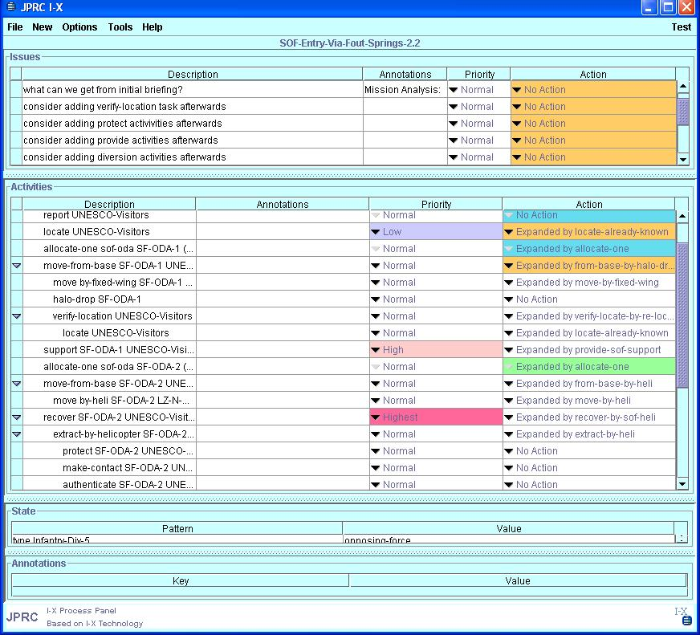
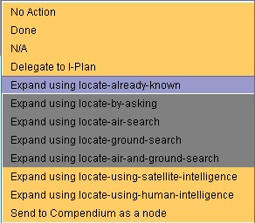
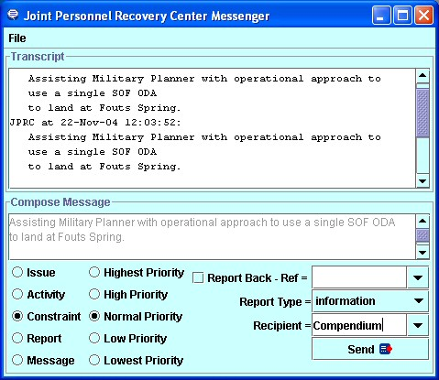
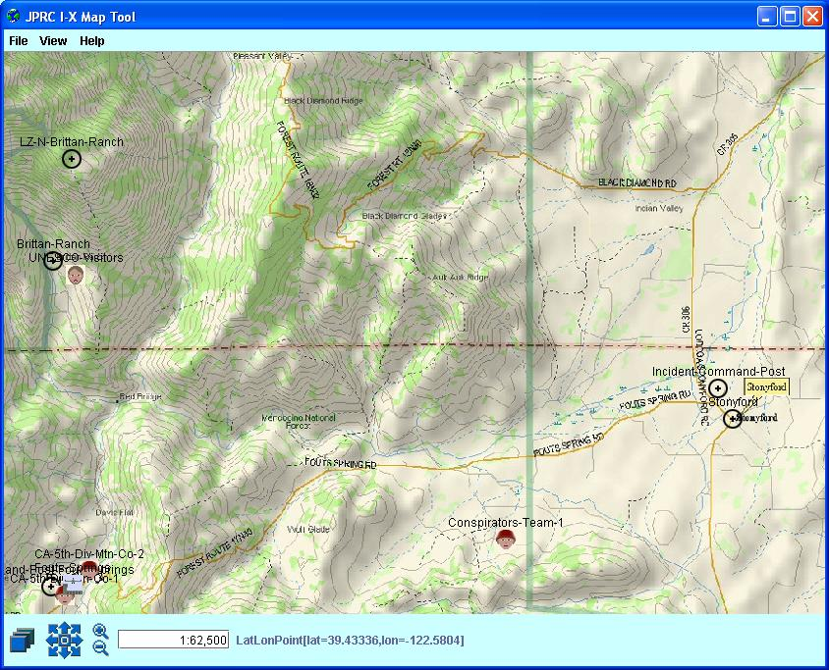
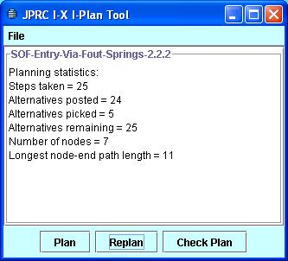
I-X – Intelligent Technology for Planning and Design
An open architecture for the creation of intelligent systems for synthesis tasks (such as planning, design and configuration) based on the handling of "issues" and the management or maintenance of the constraints describing the product of the process.
Representation - a core notion of a synthesis process and the product(s) of such processes as a set of nodes making up the process or product, along with constraints on the relationship between those nodes, a set of outstanding issues, and annotations related to these - <I-N-C-A> - Issues, Nodes, Constraints and Annotations.
Reasoning - the provision of reusable reasoning and constraint or model management capabilities.
User Interfaces - to understand user roles in performing collaborative activities and to provide generic modules which present the state of the processes they are engaged in, their relationships to others and the status of the artefacts/products they are working with.
Applications - work in various application sectors which will seek to create generic approaches (I-Tools) for the various types of Task in which users may engage.
http://www.aiai.ed.ac.uk/project/ix/

Slide 5
O-Plan – Open Planning Architecture
The O-Plan Project (1984 to 1999) explored issues of coordinated command, planning and control. It had the objective of developing an architecture within which different agents with command (task assignment), planning and execution monitoring roles could work together in a mixed-initiative fashion. It used an extendable and intelligible representation for plans - <I-N-OVA>.
Each agent has a structure which separates the following components:
the representation of the processing capabilities of an agent;
the computational facilities available to perform these capabilities;
the constraint managers and commonly used support routines which are useful in the construction of command, planning and control systems;
the decision making about what the agent should do next;
the handling of communications between one agent and others.
The main contribution of the O-Plan research was to provide a complete vision of a more modular and flexible planning and control system incorporating AI methods.
O-Plan has already been applied in areas such as:
Space Platform Construction
Satellite Planning and Control
Construction and House Building
Unix administrator's scripting
Web Services Composition
Logistics
Non-Combatant Evacuation Operations
Crisis Response Planning
Air Campaign Planning Workflow
Unmanned Autonomous Vehicles
Biological Pathway Discovery
http://www.aiai.ed.ac.uk/project/oplan/

Slide 6
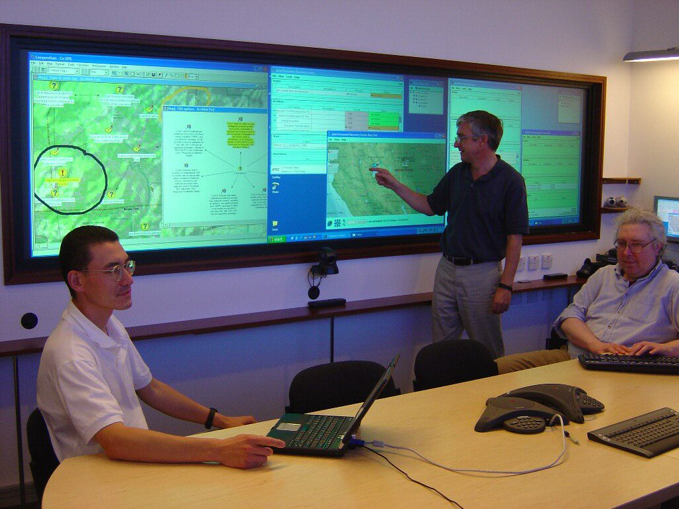
Co-OPR: Collaborative Operations for Personnel Recovery
Design and Evaluation of Collaborative Sensemaking and Planning Tools for Personnel Recovery
Combined Technologies:
AIAI - I-X - Intelligent Technology
Open University - Compendium
IHMC - KAoS - Policy Mgmt. Services
DARPA - CoABS Grid
CoAKTinG - Collaborative Advanced Knowledge Technology in the Grid
CoAX - Coalition Agents eXperiment
http://www.aiai.ed.ac.uk/project/co-opr/

Slide 7
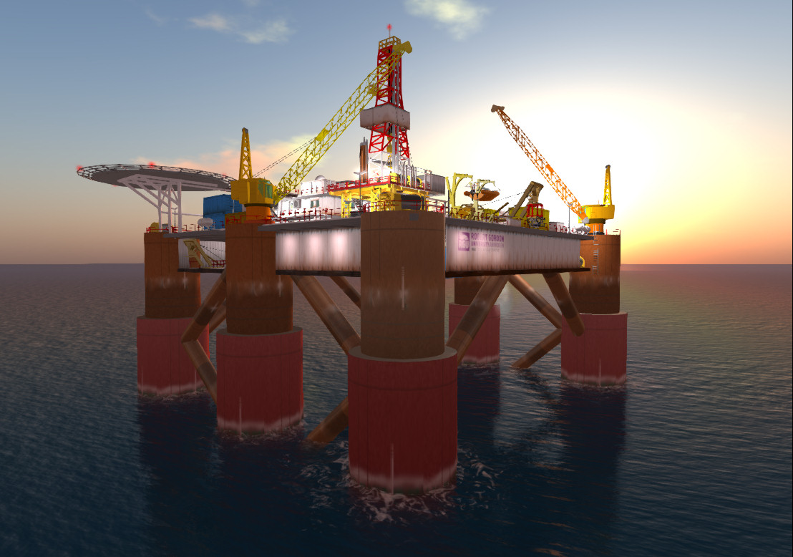
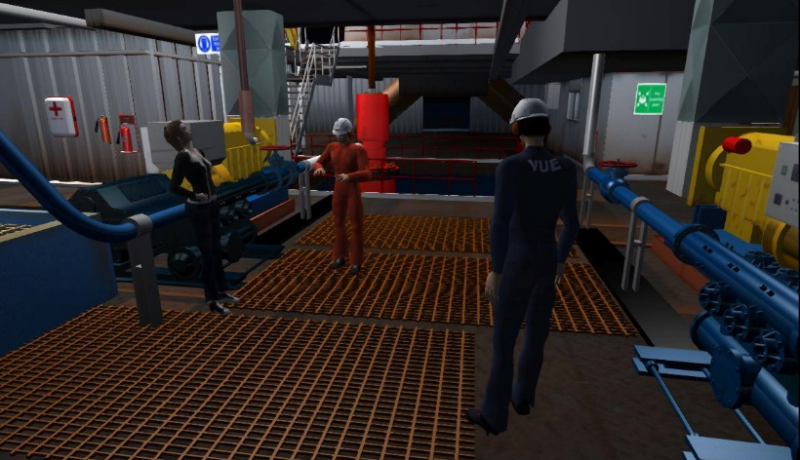
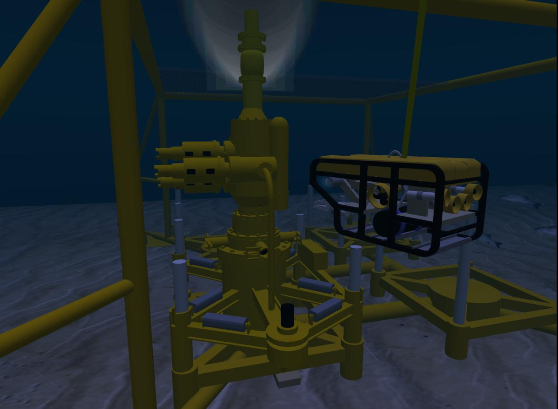
Planning for Oil Rig Blow Out Prevention
3D mesh model oil rig and sea-bed blow out preventer modelled by Robert Gordon University Oil and Gas Centre and used on Vue in OpenSim.

